Slide 1

Online Library System
Presented by-
Suraj Singh Negi (IIITU17253)
Ravina Bharti (IIITU17247)
Under guidance of-
Mr. Satish Kumar
Major Project-I (ECD-418) 1/11

Slide 2
INTRODUCTION
A library management system to manage book library of the institute.
Provides features such as add/update/delete books and view available books in the system so that admin can keep track of books.
Also allows admin to view records of students.
Provides an easy access to search for students.
Major Project-II (ECD-418) 2/11

Slide 3
PROBLEM ADDRESSED
Automation is not possible in offline system and requires manual actions.
Tracking of books is difficult for librarian.
Searching for books is a time consuming process for students.
Manual entries has to be made which can result in errors.
List of available books in library is not dynamically present.
Major Project-II (ECD-418) 3/11

Slide 4
MOTIVATION
Inspiration for the project came from our own campus library experiences-
Students had to visit library to search for books.
Had to be physically present to check their profile.
Tiresome process to check for availability of books.
Central library system only restricted to library premises.
Major Project-II (ECD-418) 4/11

Slide 5
FUNCTIONALITIES
User signup: Register a new user to the system.
Check the new username if it’s already registered to the system.
Form validation: Check if all mandatory fields are filled out. User passwords will be hashed and hashed version of passwords will be stored in the database.
User login
Major Project-II (ECD-418) 5/11

Slide 6
FUNCTIONALITIES….Contd.
List available books in the system. User can filter the results based on criteria such as book name, category, author name etc.
For Admin user(s)
Add new item
Delete item
Update item
List all items
Track all users
Major Project-II (ECD-418) 6/11

Slide 7
My Contribution
I have developed front-end required for the project using following tools for front-end web development. Our project is fully responsive across all platforms.
HTML
CSS
BOOTSTRAP
JAVASCRIPT
Major Project-II (ECD-418) 7/11

Slide 8
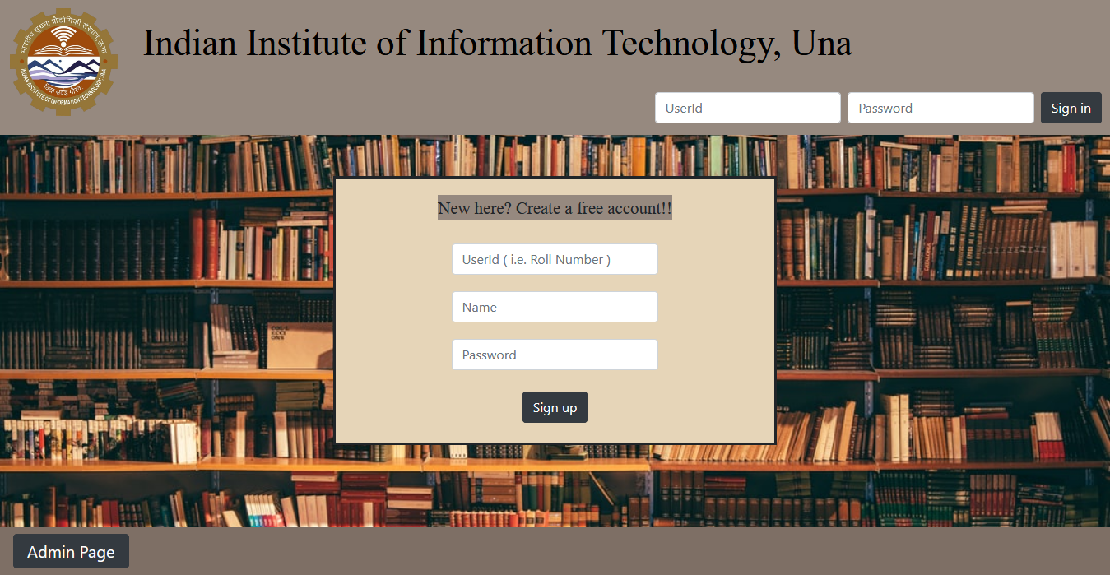
HOME PAGE
Major Project-II (ECD-418) 8/11

Slide 9
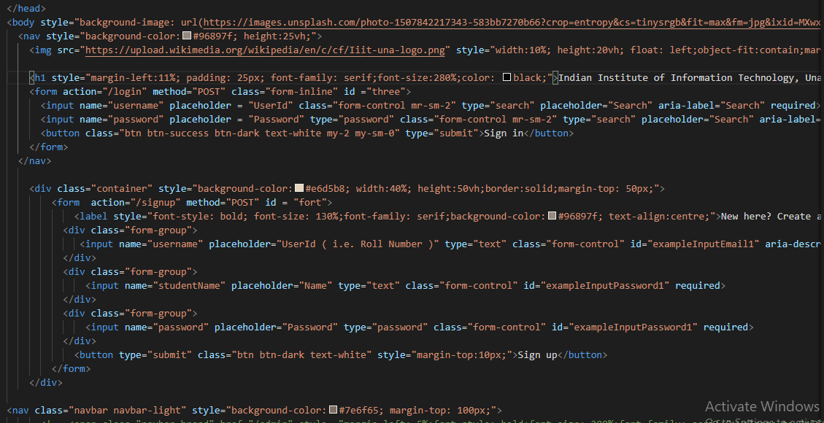
CODE SNIPPET
Major Project-II (ECD-418) 9/11

Slide 10
CONCLUSION
Web application made for easy management of library of an institution .
Frontend for the application is made using HTML, CSS and Bootstrap 4.
Caters to the need of our institute.
GitHubLink : https://github.com/007surajsinghnegi/MajorProject-LMS
Major Project-II (ECD-418) 10/11

Slide 11
THANK YOU
Major Project-II (ECD-428) IIITU16210 11/11

